Slide 1

Bangladesh Army University of Science and Technology (BAUST)
Department of Computer Science and Engineering
Health Insurance Cost Prediction Using Machine Learning
A Comprehensive Comparative Analysis
Course Title: Machine Learning Sessional
Course Code:CSE 4140
Supervised By:
Engr. Rohul Amin
Lecturer
Nadim Reza
Lecturer
Submitted By:
Masuma Sadia Sagota
220201088

Slide 2
Introduction
Insurance companies need accurate cost estimation for fair premium pricing and financial stability.
Medical costs depend on complex, non-linear factors like Age, BMI, and Smoking habits.
So, this project utilizes Machine Learning to build a robust predictive model to predict medical charges accurately.
Health Insurance Cost Prediction Using Machine Learning
1

Slide 3
Problem Statement
Insurance companies struggle to estimate correct cost.
Overcharging or undercharging creates financial imbalance.
Accurately forecasting individual medical charges is vital for premium pricing and risk management in the insurance sector.
Medical costs are driven by complex, non-linear factors (Age, BMI, Smoking).
Goal: Build a reliable ML-based prediction system.
Health Insurance Cost Prediction Using Machine Learning
2

Slide 4
Objectives
To predict insurance cost using ML models.
To identify most influential features.
To compare models and choose the best.
To enhance accuracy using preprocessing and feature engineering.
Health Insurance Cost Prediction Using Machine Learning
3

Slide 5
Key Contributions
​Performance: Achieved R^2=0.8703, surpassing previous best result (0.8538).
​Domain-Driven Feature: Engineered the Smoker BMI interaction term to capture high-risk synergy.
​Systematic Optimization: Hyperparameter tuning using GridSearchCV for ensemble models.
Health Insurance Cost Prediction Using Machine Learning
4

Slide 6
Dataset & Preprocessing Pipeline
​Dataset
Dataset contains 1,338 rows and 7 features.
​​Records: 1,338 individual records.
​Features: age, sex, bmi, children, smoker, region.
​Target Variable: charges (continuous medical costs).
​Preprocessing Steps
​Missing Values: Imputed using Median (Numeric) and Mode (Categorical).
​Encoding: Used Label Encoding for categorical features (smoker, sex, region).
​Scaling: Applied StandardScaler to all numerical features.
Health Insurance Cost Prediction Using Machine Learning
5

Slide 7
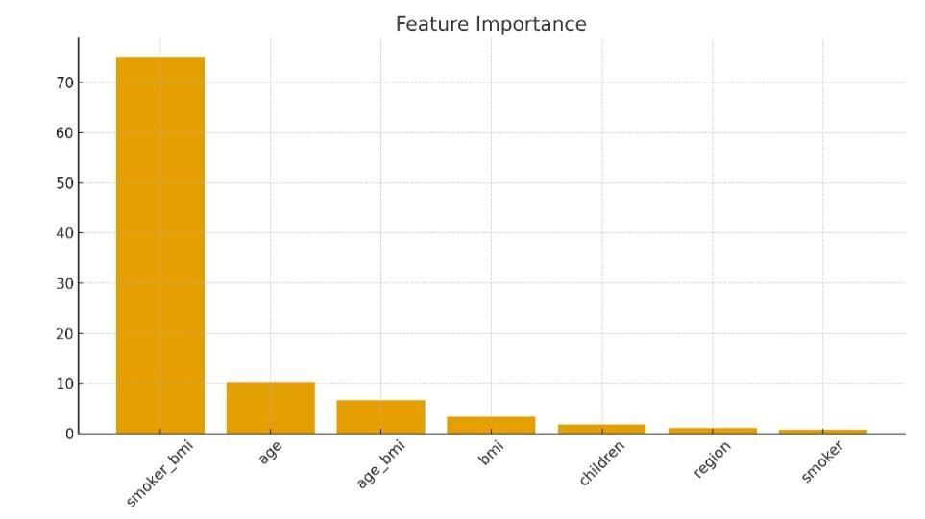
Feature Importance
Smoker_BMI: Most influential.
Age and BMI strong contributors.
Interaction features improved accuracy.
Health Insurance Cost Prediction Using Machine Learning
06

Slide 8
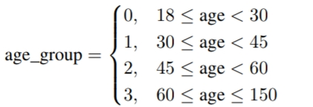
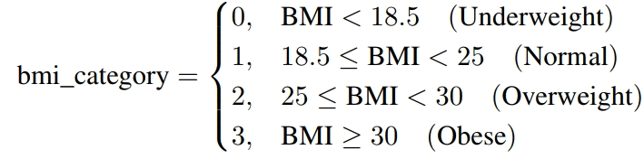


Feature Engineering
1. Based on age group .
2. Based on BMI categories .
3. Smoker_BMI interaction feature .
4. Age_BMI interaction added.
Health Insurance Cost Prediction Using Machine Learning
7

Slide 9
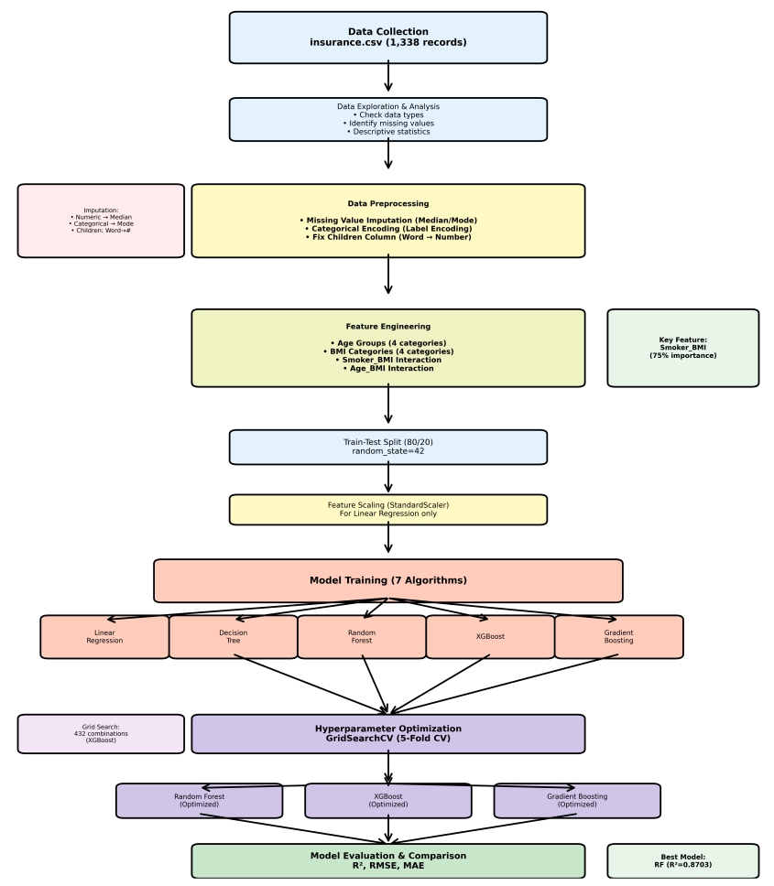
Insurance Cost Prediction Methodology
Health Insurance Cost Prediction Using Machine Learning
8

Slide 10
Models Used
Liner: Linear Regression.
​Non-Linear: Decision Tree Regressor.
​Ensemble (Focus Area):
  ​Random Forest Regressor (RFR)
  ​XGBoost Regressor (XGB)
  ​Gradient Boosting Regressor (GBR)
​Optimization Technique
​Method: GridSearchCV with 5-Fold Cross-Validation.
​Goal: Fine-tune the hyperparameters of the ensemble models (RFR, XGB, GBR) to minimize overfitting and maximize R^2 score.
Health Insurance Cost Prediction Using Machine Learning
9

Slide 11

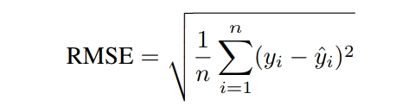

Evaluation Metrics
R² Score – Accuracy measure.
RMSE – Root mean squared error.
MAE – Mean absolute error.
Health Insurance Cost Prediction Using Machine Learning
10

Slide 12
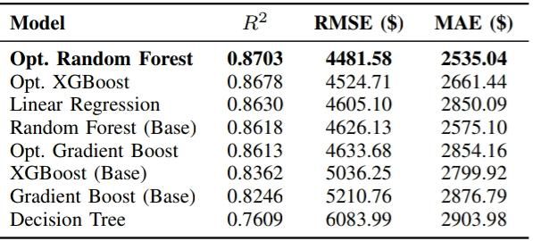
Results
Random Forest performed best.
XGBoost close.
Decision Tree showed overfitting.
Linear Regression performed surprisingly well.
Health Insurance Cost Prediction Using Machine Learning
11

Slide 13
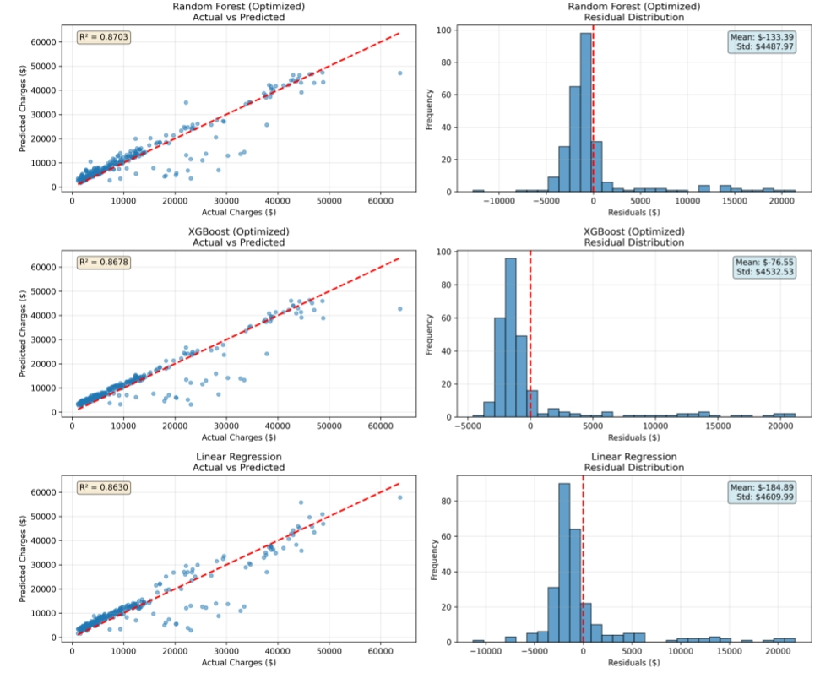
Top 3 models: Actual vs Predicted Residuals
Health Insurance Cost Prediction Using Machine Learning
12

Slide 14
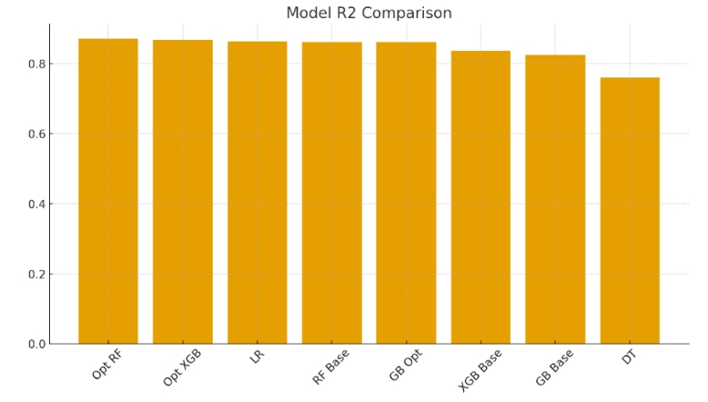
Best Model: Optimized Random Forest
Achieved R² ≈ 0.8703.
Lowest MAE and RMSE.
Captured non-linear patterns effectively.
Health Insurance Cost Prediction Using Machine Learning
13

Slide 15
Comparison With Related Works
Author | Paper Name | Model Used | R² | Limitations
Kumar et al. | Predict Health Insurance Cost using ML and DNN | Linear Reg. | 0.7699 | No standardization, limited features
Kumar et al. | Predict Health Insurance Cost using ML and DNN | Random Forest | 0.8538 | Poor preprocessing, overfitting risk
Aishwarya et al. | Health Insurance Cost Prediction App | Random Forest | 0.8557 | Random features, not robust
Sharma et al. | Prediction Of Medical Insurance Cost | Linear Reg. | 0.7489 | No encoding, low data diversity
J. Paul et al. | Analysis & Prediction w/ KNN | KNN Regr. | 0.5521 | No standardization, non-linear relationships
This Study | Health Insurance Cost Prediction Using Machine Learning | Opt. RF | 0.8703 | No medical history data, trained on single-region dataset.
Outperformed previous academic benchmarks.
Achieved +1.65% better R² than best published score.
Health Insurance Cost Prediction Using Machine Learning
14

Slide 16
References
V. Kumar et al., “Predict Health Insurance Cost using ML and DNN Regression Models,” International Journal of Creative Research Thoughts (IJCRT), vol. 10, no. 3, Mar. 2022.
Aishwarya et al., “Health Insurance Cost Prediction App,” International Journal for Research in Applied Science and Engineering Technology (IJRASET), vol. 11, no. 4, 2023.
H. Sharma et al., “Prediction Of Medical Insurance Cost Through Linear Regression Model,” ResearchGate, 2020.
J. Paul et al., “An Analysis & Prediction of Health Insurance Costs using KNN Regressor in R,” Journal of Advanced Research in Engineering and Technology, 2024.
T. Hunter et al., “The Impact of Smoking and Obesity on Healthcare Costs: An Interaction Model,” Journal of Actuarial Science, 2021.
Health Insurance Cost Prediction Using Machine Learning
15

Slide 17
Strengths of System
Proper preprocessing.
Strong feature engineering.
Model optimization.
High prediction accuracy.
Health Insurance Cost Prediction Using Machine Learning
16

Slide 18
Limitations
Dataset is not too large.
No medical history data.
Model trained on single-region dataset.
Health Insurance Cost Prediction Using Machine Learning
17

Slide 19
Future Improvements
Add neural networks.
Use larger datasets.
Deploy system as web app.
Health Insurance Cost Prediction Using Machine Learning
18

Slide 20
Conclusion
ML successfully predicts insurance cost.
Optimized Random Forest best.
Useful for insurance companies.
Health Insurance Cost Prediction Using Machine Learning
19

Slide 21
    Thank You
Health Insurance Cost Prediction Using Machine Learning
20

